Slide 1
It's a poll not an election! Analysis of metagenomes and metatranscriptomes using probabilistic compositional approaches
Greg Gloor
Department of Biochemistry
University of Western Ontario
https://github.com/ggloor/compositions/presentations
ggloor@uwo.ca @gbgloor
Notes:
Datasets collected by high-throughput sequencing of amplicons, or shotgun sequencing of metagenomes or metatranscriptomes are commonplace. These datasets are used to study human health and disease, ecological niches, and the built environment. Datasets collected in this way are limited by the capacity of the machine and so are necessarily probabilistic samples of the underlying environment. However, many investigators are either unaware of this or assume specific properties of the data that confound the analyses. This confounding leads to both false positive and false negative results. I will introduce the concept of probabilistic sampling and of compositional data and describe their properites and pathologies. I will provide examples from vaginal meta-transcriptomes and gut metagenomes that demonstrate the general utility of the approach. I will finally give guidance and point to resources and examples for the analysis of microbiome datasets using compositional data analysis.

Slide 2
Imagine
If the analysis was simple, scalable and robust
If the results told us something about the environment directly
If the same conclusion could be obtained from different datasets or subsets of the original dataset
If the analysis was on a firm theoretical foundation

Slide 3
Why sequence meta-*omes
Fame? 🏆
Money? 💰
Ennui ? 👻
Curiosity? 🧠
Because we want to understand the environment
🐙🦑🦐🦀🐡🐋🦈 vs 🐇🦌🐀🐿🦔🦒

Slide 4
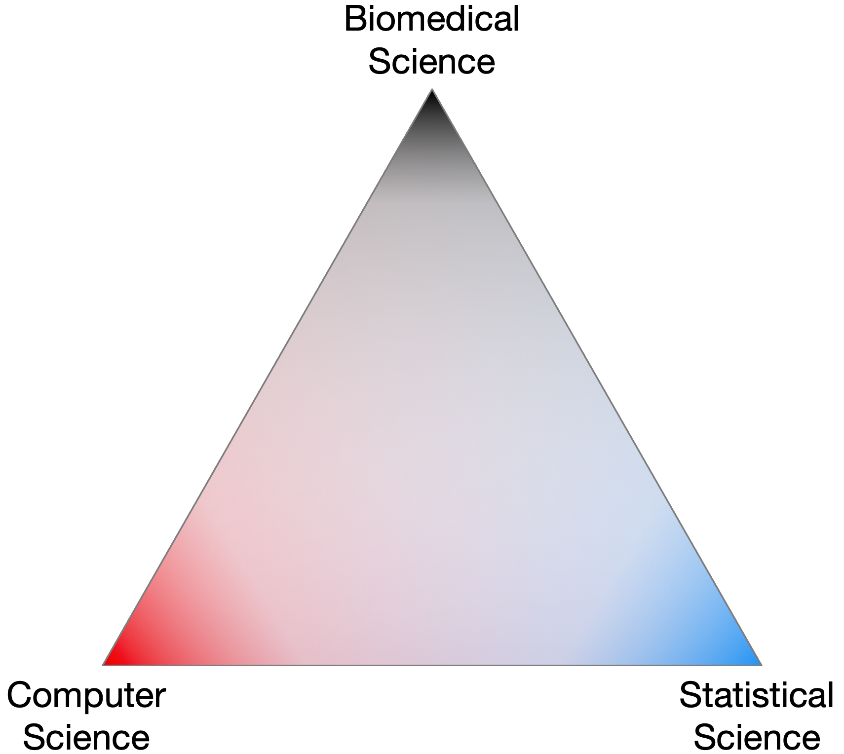
The triangle of trust
Notes:
Complex data and everyone trusts everone else without necessarily having the domain-specific expertise needed

Slide 5
Nobody sees the whole elephant

Slide 6
Researcher degrees of freedom

Slide 7
Tenuous connection to reality?

Slide 8
Outline
Place the analysis on a firm foundation
Probabilities and CoDa
The results inform directly about the environment
Show the conclusions are reproducible
Meta-transcriptomics
The analysis is simple, scalable and robust

Slide 9
The sequencing meat grinder

Slide 10
Sequencing is random sampling
Notes:
Starting with a of molecules composed of Tigers and Ladybugs
We take a random sample, how many Tigers and how many Ladybugs
If we count a given random area we can infer how many off each there are in entire set

Slide 11
Sequencing is a probabilistic sample
Notes:
Starting with a of molecules composed of Tigers and Ladybugs
We take a random sample, how many Tigers and how many Ladybugs
If we count a given random area we can infer how many off each there are in entire set

Slide 12
We need multiple polls to approximate truth
Gloor, et al. 2016. Ann Epidemiology
Gloor, et al. 2016. Can J. Micro.
Gloor, et al, 2017. Front. Micro.
Notes:
A 0 count in a sample may be a 0 probability, or it may not. If the feature in any sample has a count greater than 0, then by definition the expected value of the probability in all samples for that feature is greater than 0

Slide 13
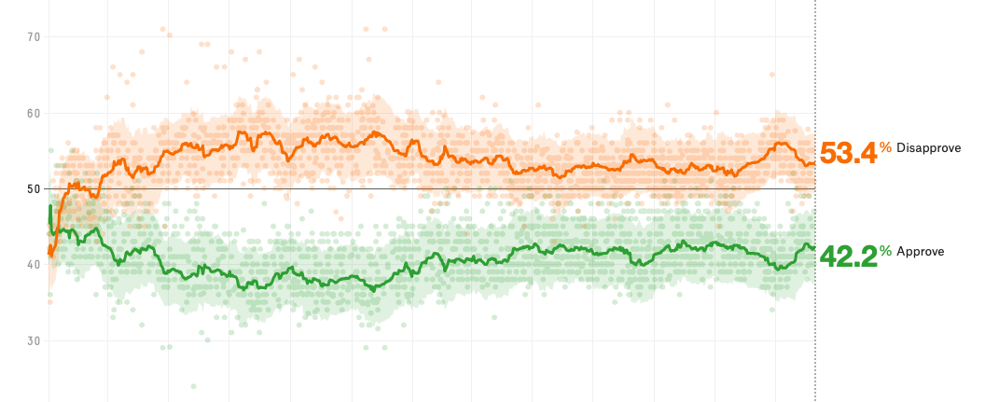
Polls have error – are they fake news?
Prop | Size | moe.form | Dir.moe | Norm.size | Norm.moe
0.2 | 1000 | 0.025 | 0.024 | 479.8 | 0.036
0.2 | 100 | 0.078 | 0.072 | 479.8 | 0.036
0.25 | 250 | 0.054 | 0.052 | 440.4 | 0.040
0.19 | 2000 | 0.017 | 0.017 | 488.5 | 0.035

Slide 14
Normalization is statistical malpractice
Prop | Size | moe.form | Dir.moe | Norm.size | Norm.moe
0.2 | 1000 | 0.025 | 0.024 | 479.8 | 0.036
0.2 | 100 | 0.078 | 0.072 | 479.8 | 0.036
0.25 | 250 | 0.054 | 0.052 | 440.4 | 0.040
0.19 | 2000 | 0.017 | 0.017 | 488.5 | 0.035
If bioinformaticians were political pollsters we would be sued by our clients

Slide 15
Random data as counts
Example 100 random sample sets
range=1800-2200
range= 8000-12000
range=450-550
🐯
🐞
👽

Slide 16
Same random data as proportions/probabilities
Constant sum of 1000
Constant sum operations:
Sequencing
percentage, relative abundance, probability, proportion
Count normalization
Rarefaction
Gloor, et al. 2016. Ann Epidemiology
Gloor, et al. 2016. Can J. Micro.
Gloor, et al, 2017. Front. Micro.

Slide 17
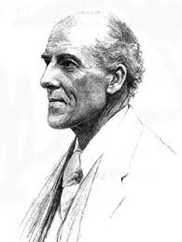
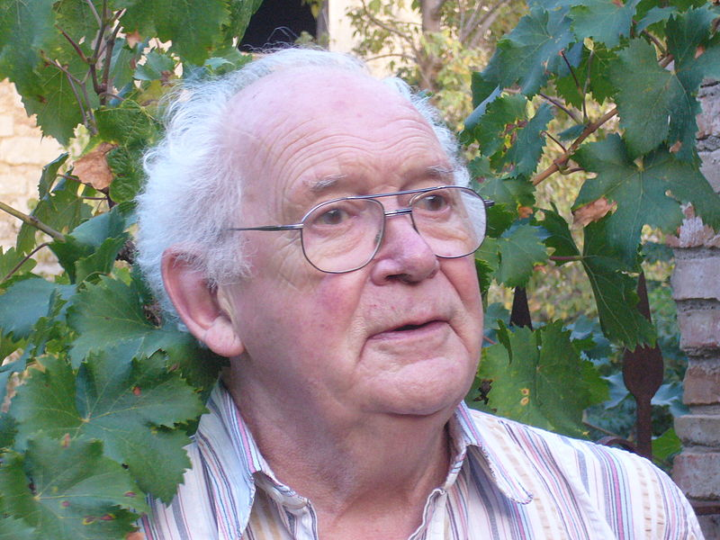
We have CoDa
Compositional data are logically inconsistent with most tools in common use (Pearson 1897)
correlation, PCA etc.
Sequencing, negative binomial, rarefaction, ZIG
Work in log ratios
Aitchison and others
Conceptually similar to qPCR
Aitchison 1986

Slide 18
CoDa properties and *lr
Count
Sequencing
Simplex
27
853
66
740
112
216
Simplex: one fewer dimensions than variables
Problems remain regardless of dimension
*lr(x) = [ log(x₁/g_{X}), log(x₂/g_{X}), … log(x_{D}/g_{X}) ]
X = [ x₁, x₂, … x_{D} ], g_{X} = geometric mean of X (or subset)
Probabilities
Some invariant
Relative values
Multivariate Poisson
Aitchison 1986. Stat. Anal. Comp Data
Pawlowsky-Glahn, 2015. Mod. Anal. CoDa
Notes:
Scale dependence - hence ‘normalization’
Correlation and covariation are unreliable
Addition and subtraction are not useful operations
Subsetting and aggregating are problematic
Sparse data is an issue

Slide 19
The CoDa approach
Theoretical foundation
Gives same answer with sequence data and counts
Based on variance not abundance
Internally consistent
Univariate and multivariate approaches agree
Probabilistic
Matches the data
Robust
Upstream decisions have less effect

Slide 20
Metatranscriptome example using Bacterial vaginosis
Marked asymmetry in composition
H is predominantly Lactobacillus sp.
BV is mixed bag of anaerobes with L. iners
We must assume something is invariant
Good example dataset since have a good idea of the ‘truth’
Exploratory biplots
Differential abundance
Compare datasets

Slide 21
Datasets
Group A
Unpublished (Macklaim, McMillan et al) and “A multi-platform metabolomics approach identifies highly specific biomarkers of bacterial diversity in the vagina of pregnant and non-pregnant women” Sci. Rep. 2015
Vaginal swab, Illumina (ABI)
Antibiotic naïve (both)
Cross-sectional
Group B
“Metatranscriptome Analysis of the Vaginal Microbiota Reveals Potential Mechanisms for Protection against Metronidazole in Bacterial Vaginosis” Deng et al mSphere 2018
Vaginal fluid, Illumina,
Antibiotic naive (BV), Antibiotic treated (H)
Mgnify, PRJEB21446

Slide 22
Example sample set by 16S rRNA gene sequencing
Healthy
Bacterial Vaginosis (BV)
Notes:
Here’s as example to show you what I mean
This is the 16S rRNA gene sequencing output of the human vaginal microbiome. Each bar is a sample and each color is a taxonomic member of the community
Under typical healthy conditions is it a low diversity community with each sample dominated by one species of these blue Lactobacilli
A dysbiotic shift can happen where there is a drastic change to a high-diversity community called bacterial vaginosis (BV) on the right. You can hopefully see they are quite different communities
Click: Some organisms change abundance, like Lactobacillus iners
Click: Some organisms present in one condition are almost entirely absent in another like Atopobium

Slide 23
Metatranscriptomics (ie. meta-RNAseq)
Bacterial mRNA seq
Reference genome CDS
Assembly of novel ORFs
90% sequence ID clustering: refseqs
Part 2
Organism-specific
Read mapping
Part 1
Group by SEED subsys4
Function
Macklaim, Gloor MIMB 2018
Notes:
This is a very distilled down workflow for how we generated the data
There are a few steps before, but we get to a point where we have enriched bacterial mRNA reads
We then do two things:
1. Collect putative coding sequences from reference genomes
Assemble de-novo and predict open reading frames (ORFs)
The sequences are clusters into 90% sequences identity refseqs that we map to
From these we retain the organism or taxonomic information
But we also take those refseqs and group them functionally using the SEED subsystem database

Slide 24
Part 1: Function
Group refseqs by same function
Examine at the ecosystem rather than the organism level
e.g. sum counts for the gene for each enzyme (structural protein, etc) in all organisms
Taxonomic information is lost
Reduces from 300k genes to ~6000 functions
Sparsity is much reduced
Generally robust

Slide 25
Part 1: PCA - platform
Variance of ratios of functions (red)
Distance (samples)
Platform has negligible effect if sampling methods are the same
Highlighted samples from ABI-Solid
All others Illumina HiSeq
BV-2
H-1,2
BV-1

Slide 26
Part 1: Core functions invariant
Housekeeping …
Cell division protein MraZ
D-tyrosyl-tRNA(Tyr) deacylase
Deoxyuridine 5'-triphosphate nucleotidohydrolase (EC 3.6.1.23)
DNA ligase (EC 6.5.1.2)
FIGfam135315: Iojap-related protein
LSU ribosomal protein L3p (L3e)
Membrane-associated zinc metalloprotease
Peptide chain release factor 3
Ribosomal large subunit pseudouridine synthase B (EC 4.2.1.70)
Signal peptidase I (EC 3.4.21.89)
Transcription-repair coupling factor
Translation elongation factor Ts
tRNA nucleotidyltransferase (EC 2.7.7.21) (EC 2.7.7.25)
Tryptophanyl-tRNA synthetase (EC 6.1.1.2)
core

Slide 27
Part 1: Samples
BV-2
H-1,2
BV-1

Slide 28
Part 1: Functions
BV-2
BV = biosynthesis/TCA
BV1 = Flagella
H = aa/sugar
H
BV-1

Slide 29
Part 1: BV1 vs. BV2

Slide 30
Part 1: Datasets
Group A
Unpublished (Macklaim, McMillan et al) and “A multi-platform metabolomics approach identifies highly specific biomarkers of bacterial diversity in the vagina of pregnant and non-pregnant women” Sci. Rep. 2015
Vaginal swab, Illumina (ABI)
Antibiotic naïve (both)
Cross-sectional
Group B
“Metatranscriptome Analysis of the Vaginal Microbiota Reveals Potential Mechanisms for Protection against Metronidazole in Bacterial Vaginosis” Deng et al mSphere 2018
Vaginal fluid, Illumina
Antibiotic naive (BV), Antibiotic treated (H)
Mgnify, PRJEB21446

Slide 31
Part 1: The importance of sample collection and handling
Same sequencing platform, & read processing & bioinformatics
Samples separate by BV status and by group
Antibiotic exposure, sample collection and handling different
Healthy
BV
Group B
Group A

Slide 32
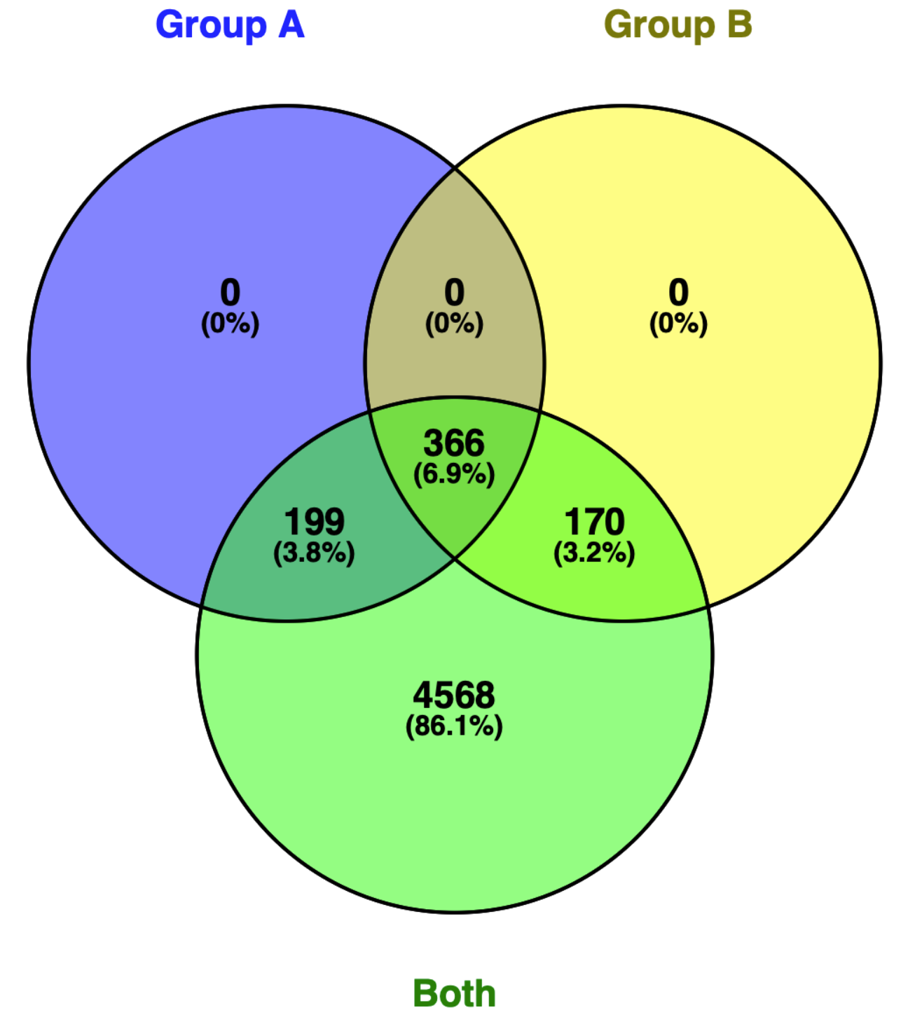
Part 1: Common up in BV - gpA vs gpB
H
BV
Notes:
Overall results are robust
Large majority of functions effect >2 in both
Almost all of the remainder effect > 2

Slide 33
Part 1: Summary functions
Samples group by function
One type of healthy samples
Two types of BV samples
Some functions are conserved regardless of the community members
Approach assumes ecosystem is more important than any organism

Slide 34
Part 2: RefSeq - Abundance != function
Notes:
These are the same data I just showed you, but represented in taxonomic abundance barplots at both using 16S (top) and by mRNA (bottom)
By hierarchical clustering of the transcriptome, there are four main subgroups: two associated with health on the left in blue, and two associated with BV on the right
What I want to show you is the difference between the taxonomic contributions at the 16S level (the top plot) compared to the taxonomic contributions from the mRNA level (bottom plot)
This is summarized per taxon in the boxplots on the left
In some cases, like the blue L. crispatus organism, it’s punching above it’s weight and contributing more transcriptionally than you’d expect
And in other cases, like the white Atopobium organism there is hardly any transcriptional activity compared to the 16S abundance

Slide 35
Part 2: Reference sequence pangenomes
Variance of ratios of RefSeqs
~300000 RefSeqs

Slide 36
Part 2: Reference sequence pangenomes
Variance of ratios of RefSeqs
~300000 RefSeqs
RefSeqs cluster
by ‘species’
Genomes cluster because of shared function (Almeida 2019) and expression (this data)
L. iners
L. crispatus
Megasphaera
Megasphaera

Slide 37
Part 2: Reference sequence
Healthy samples also cluster by species
BV samples separate by expression of Megasphaera and an unknown species
Majority of assembled refseqs in lower right Q
H2
BV-2
H1
BV-1

Slide 38
Part 2: and metabolome
Macklaim, Macmillan unpublished
Macmillan Sic Rep 2015

Slide 39
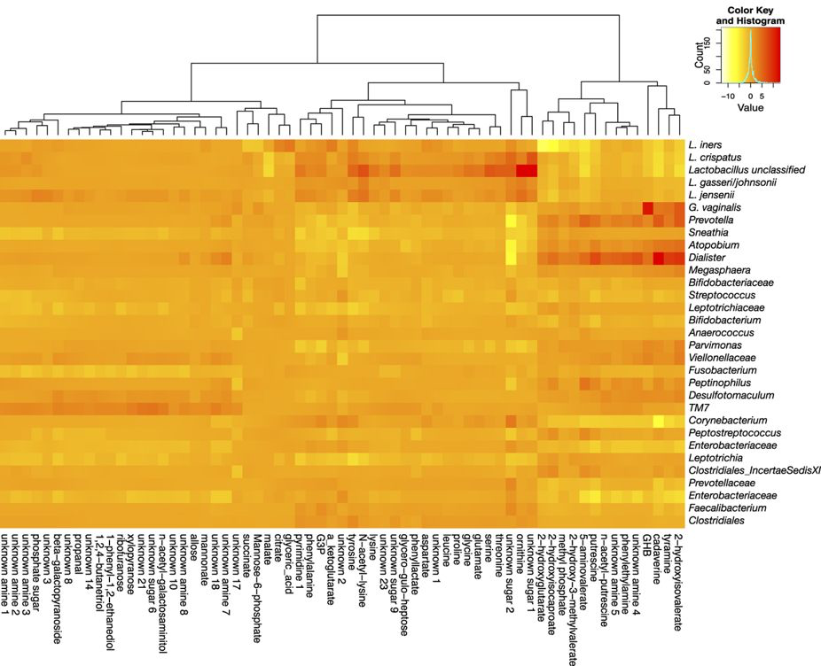
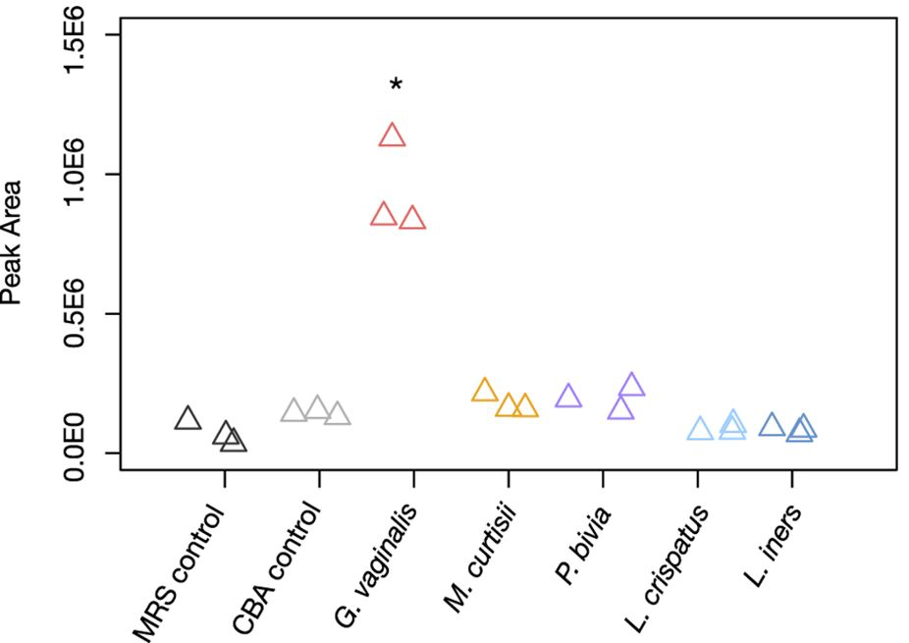
Part 2: Merging metabolome, microbiome, metatranscriptome
G. vaginalis correlates with GHB
G. vaginalis has part of the pathway to make GHB
G. vaginalis produces GHB in vitro
McMillan et al. 2015 Sci Rep

Slide 40
Part 2: Summary
Massive sparse datasets
~300k refseq genes
Refseqs group by taxonomy and expression
Can be multiple ‘strains’
Community members can cooperate, compete or ignore
Who is there, what they are doing and what they have
Combining different ‘omics data (e.g. mRNA and metabolites) remains an open problem
Metabolome + metaRNAseq provides a high-resolution, holistic view of a complex system
Agreements (H v BV: amines, succinate)
different resolution

Slide 41
If we try hard we can see the whole

Slide 42
Some available CoDa tools
Outliers & filters
CoDaSeq (github.com/ggloor)
Exploratory data analysis
Compositional biplots (compostions - CRAN)
omicplotR (Dan Giguere: github.com/dgiguer/omicplotR/wiki)
philr (Bioconductor)
Differential abundance
ALDEx2 (Bioconductor)
selbal
ANCOM (QIIME)
Compositional association
propr (CRAN)

Slide 43
Closer to the reality of the environment
Abundance
Variance
Count
Ratio
ML
Distribution

Slide 44
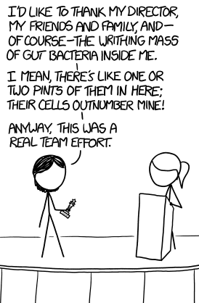



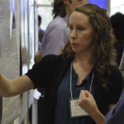



Acknowledgments
Andrew
Fernandes
Jean
Macklaim
Vera Pawlowsky-Glahn
Juan Jose Egozcue
Justin Silverman
philr
Tom Quinn
propr
🐯
🐞
👽
Gregor Reid
Jeremy Burton
Amy McMillan
Daniel Giguere
Jia Rong Wu
Coming soon:
Rob Finn et al.
Mgnify@EBI
Notes:
Many more fragments than we can count

Slide 45
ALDEx2: model the ‘polling’ error
Generate posterior estimates of the data consistent with the observed data and the chosen prior(s)
Dirichlet instances
*lr transform instances
Calculate test values on each DIR MC instance
Correct for FDR
Report the expected value of each test across instances
Dramatically reduces false positives with little or no loss of sensitivity for essentially any seq*omics dataset
Group 1 Group 2
Fernandes, et al. 2013. PLoS ONE
Fernandes, et al. 2014. Microbiome
Thorsen et al. 2016 Microbiome
Quinn et al. 2018 Bioinformatics
Notes:
Many more fragments than we can count

Slide 46
Normalization is no help at all
🐯
🐞
👽
Once data are on the simplex, they cannot be recovered without
⌛️ 💲 🏋🏼‍

